Slide 1
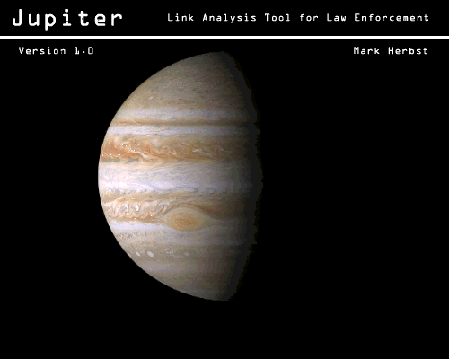
Design Presentation

Slide 2
Project Overview:
Develop a secure, platform independent, Windows-based link analysis software application that can be used globally.

Slide 3
What is Link Analysis?
The process of consolidating and organizing relational data and presenting the data into meaningful graphical representations which depict patterns, associations and relationships.

Slide 4
Focus: Market Segment
Intended users of Jupiter:
  Investigators
  Prosecutors
  Intelligence Analysts

Slide 5
Global Use
Jupiter is designed for Global use.
Through the use of text-based .properties files or Resource Bundles, Jupiter can be configured for use in different languages.

Slide 6
Internationalization
Resource Bundles: A resource bundle contains locale-specific objects
For example, strings representing messages to be displayed in your application. The idea is to load a specific bundle of resources, based on a particular locale.

Slide 7
Jupiter’s Resource Bundles
JupiterStrings.properties: Strings for the application
  Titles, Labels, Menus, Exceptions…
CountryStrings.properties: List of countries
USStateStrings.properties: List of states in the United States

Slide 8
Data Storage
Jupiter uses Hibernate version 3.0 to integrate with Carroll College’s Oracle 9i database.
Stored data is accessed through Hibernate via .xml based configuration and mapping files.
Therefore, IT administrators can choose to access data from:
  A pre-existing database
  Multiple databases
  Use the database that accompanies the application.

Slide 9
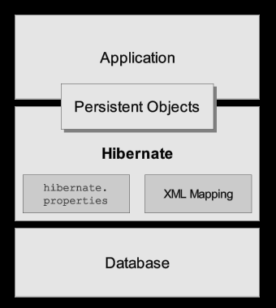
Jupiter Design Overview

Slide 10
Link Analyses
Persons
Organizations
Events
Phones
Phone Calls
Addresses
Notes

Slide 11
Persons
Name
  Types:
    English (First, Middle, Last)
    Hispanic (First, Fathers, Mother’s Maiden)
    Arabic (First, Fathers, Grandfather’s, Family’s)
    Alias (ex. “K-Tone”, “Woody” , “9 to 5" )
Gender
  Male or Female
Race
  Asian, Black, Hispanic, Indian, White, Unknown
Date of birth

Slide 12
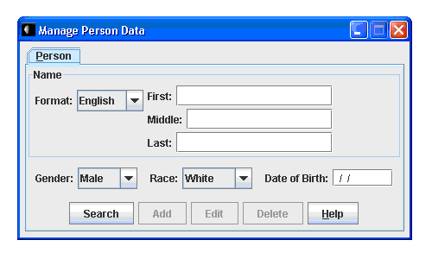
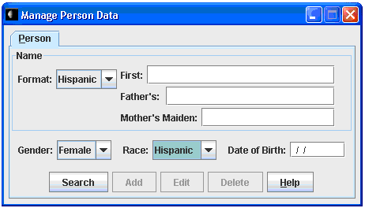
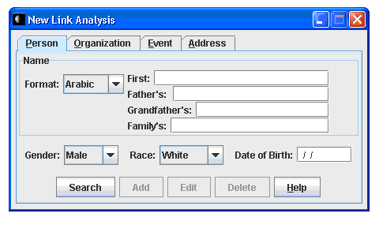
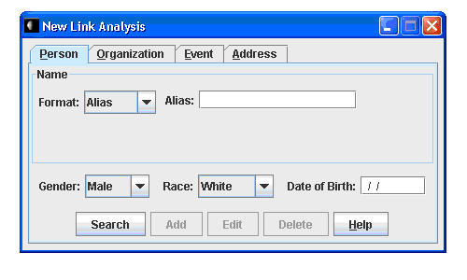
Person

Slide 13
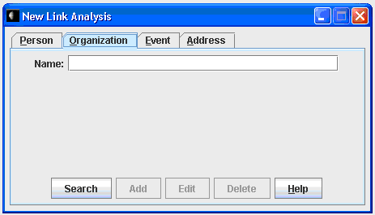
Organizations
Jupiter stores only the name of an Organization.
Notations for a specific Organization can be linked by the use of a Note.

Slide 14
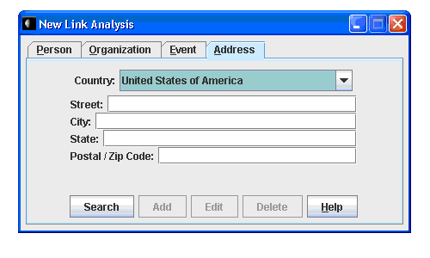
Addresses
Country
Default format (US):
  Street (123 Elm St)
  City (Chicago)
  State (Illinois)
  Zip Code (34555)

Slide 15
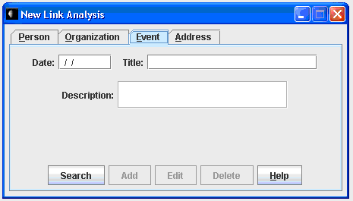
Events
Date of the Event
Event Title: Limited to 30 characters. Example: Oklahoma City Bombing
Event Description: A brief description of the Event limited to 50 characters.

Slide 16
Phones
Locale-Specific format
Default US: (###) ### - ####
  Area code
  Exchange
  Subscriber

Slide 17
Phone Calls
Type
  Incoming
  Outgoing
Date
  MM/DD/YYYY
Time
  Military time (ex. 1500 hours)
Duration
  Minutes
From
To

Slide 18
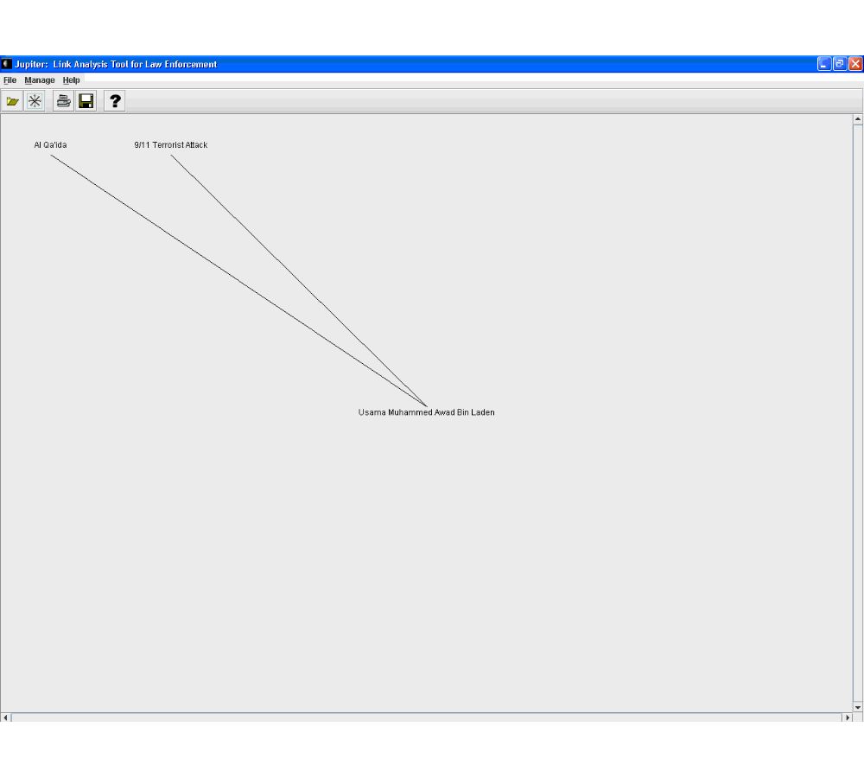
Example Diagram

Slide 19
Help File
Jupiter has an .html based Help File

Slide 20
Learning Experiences:
Integration of complex components
Layered application design
Internationalization (Globalization)
Enhanced organization and presentation skills

Slide 21
Future Enhancements
Deploy with an HSQLDB database.
  HSQLDB is an SQL (Structured Query Language) relational database engine written in Java.
  HSQLDB is best known for being bundled with Hibernate.
Improve Graphing with Prefuse.
  Prefuse supports a rich set of features for data modeling, visualization, and interaction.
  Prefuse is written in Java, using the Java 2D graphics library, and is easily integrated into Java Swing applications or web applets.
Allow the import of phone record data from a .CSV file.

Slide 22
Sources
http://java.sun.com/developer/TechTips/1998/tt0521.html#tip2
http://docs.jboss.org/ejb3/app-server/Hibernate3/reference/en/html_single/index.html
http://www.usdoj.gov/usao/nye/pr/2007/2007Apr11.html
http://prefuse.org/
http://www.hsqldb.org/

